Slide 1
DQN using Frames
Benny Bornfeld

Slide 2
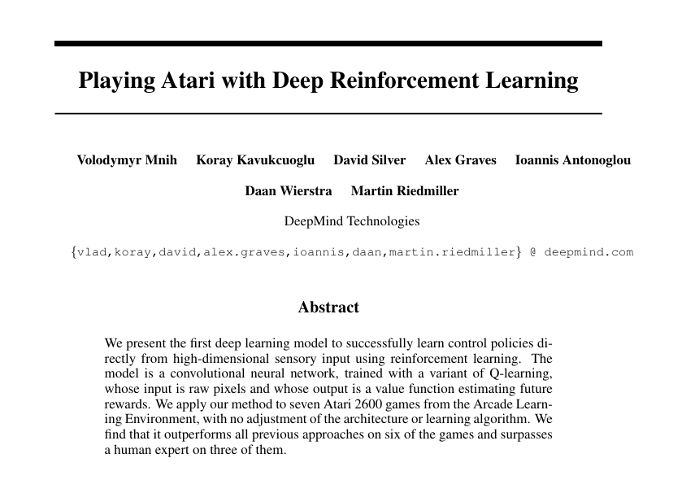
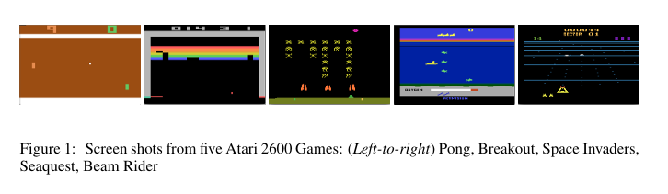

Slide 3
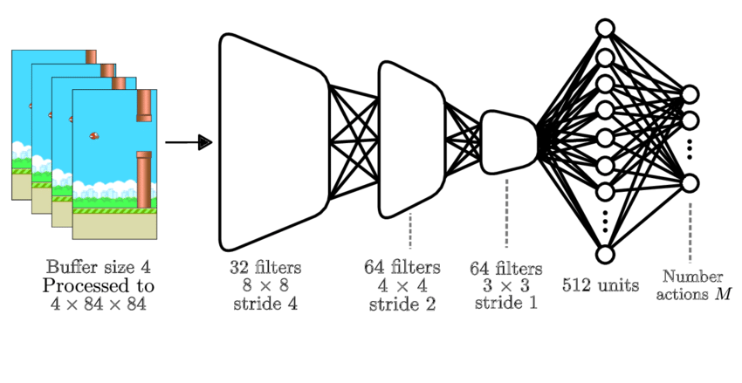

Slide 4
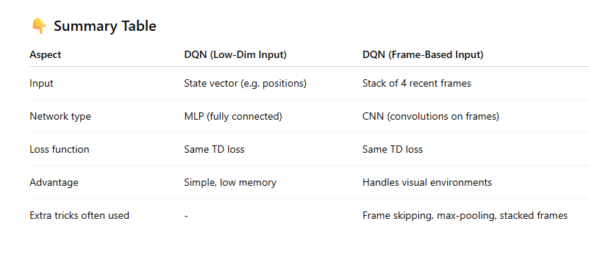
Comparing Frame Based Input to a Low-Dim Input
https://research.google/blog/from-pixels-to-actions-human-level-control-through-deep-reinforcement-learning/

